Slide 1
Web Application?
Graduating TO make Wed apps

Slide 2
Overview
Where to Start, What to do and How?
Fullstack, Backend vs Frontend
Technology stack
Testing, Testing and Testing, cause you can’t have enough test.
Mockito
Protractor
SQL vs No-SQL which to use for your application.
MySQL
MongoDB
Combining it all together and deploying it hopefully.
Spring Boot with Angular 6 on a Docker Container

Slide 3
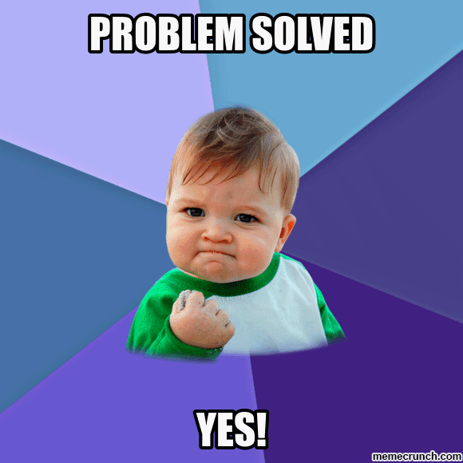
Where to Start, What to do and How?
Problem?
Sometime the greatest idea comes from solving the simplest things.
Solving the Problem?
Technology stack
Break down the problem
Notes:
Sometime the greatest idea comes from solving the simplest things.

Slide 4
Full-Stack Development
Notes:
https://medium.com/@sepandassadi/become-a-full-stack-web-developer-free-resources-8a1c2c0ebd41

Slide 5

Back-End
Spring and Sprint Boot
Spring
Spring MVC
Spring Boot
Java 1.8
Gradle vs Maven
https://dzone.com/articles/gradle-vs-maven
Layered Architecture
Notes:
Spring Framework is an application framework
Spring Boot is basically an extension of the Spring framework which eliminated the boilerplate configurations required for setting up a Spring application.
Spring Boot makes it easy to create stand-alone, production-grade Spring based Applications that you can "just run".
Spring MVC is a sub-project of the Spring Framework, targeting design and development of applications that use the MVC (Model-View-Controller) pattern
Gradle is a build automation system that is fully open source and uses the concepts you see on Apache Maven and Apache Ant. It uses domain-specific language based on the programming language Groovy, differentiating it from Apache Maven, which uses XML for its project configuration. It also determines the order of tasks run by using a directed acyclic graph.
Maven is used for project build automation using Java. It helps you map out how a particular software is built, as well as its different dependencies. It uses an XML file to describe the project that you are building, the dependencies of the software with regards to third-party modules and parts, the build order, as well as the needed plugins. There are pre-defined targets for tasks such as packaging and compiling.

Slide 6
Front-End
JavaScript vs Typescript
Vue.js vs React.js vs Angular
https://vuejs.org/
https://reactjs.org/
https://angular.io/
Angular MVC
Notes:
JavaScript (JS) is a lightweight, interpreted, or just-in-time compiled programming language with first-class functions.
https://developer.mozilla.org/en-US/docs/Web/JavaScript
TypeScript is an open-source programming language developed and maintained by Microsoft. It is a strict syntactical superset of JavaScript, and adds optional static typing to the language. TypeScript is designed for development of large applications and transcompiles to JavaScript.
https://www.typescriptlang.org/

Slide 7
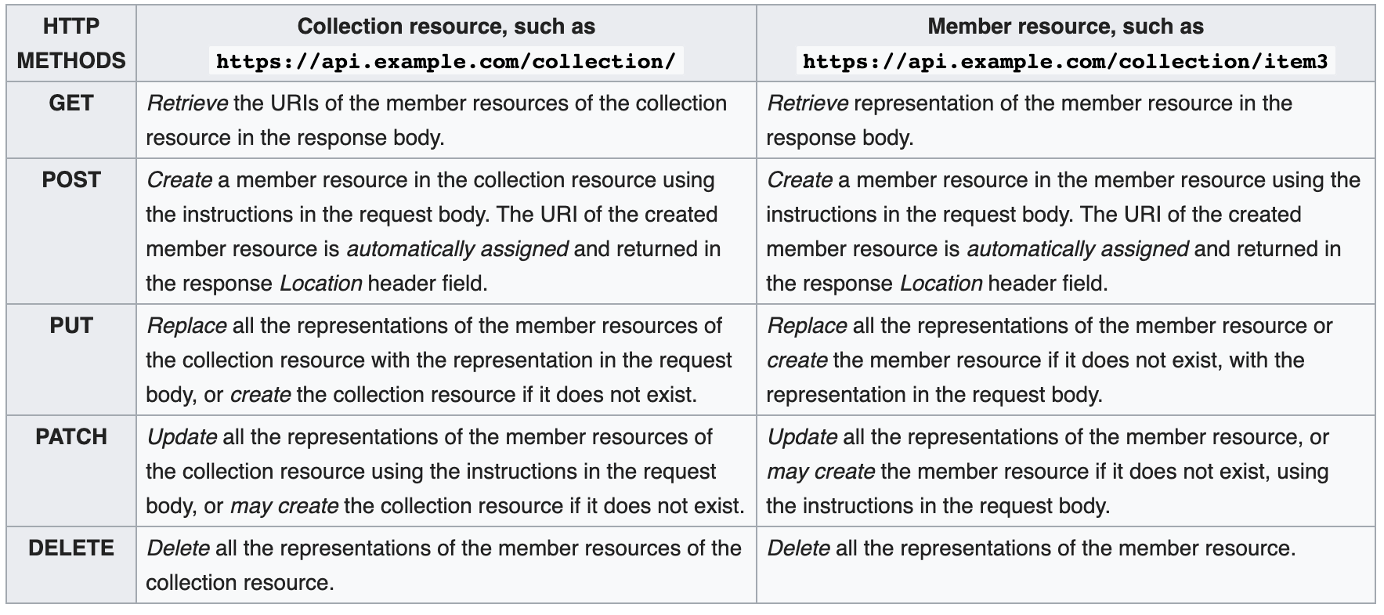
REST
Notes:
Representational State Transfer
https://restfulapi.net/

Slide 8
APIs
Google API
https://developers.google.com/places/web-service/intro
YELP API
https://www.yelp.com/developers/documentation/v3
Open Data NI
https://www.opendatani.gov.uk/
Notes:
implementation 'com.google.maps:google-maps-services:0.9.3’
implementation 'org.springframework.boot:spring-boot-starter-web’
implementation 'org.apache.commons:commons-lang3:3.0'

Slide 9
Planning and Tracking your progress
Trello
https://trello.com/
Jira
https://www.atlassian.com/software/jira
Github
https://github.com/Jgiron455/webapp-workshop

Slide 10
Testing, Testing and Testing, cause you can’t have enough test.

Slide 11
Keep Your Code Clean
Naming Convention
Write What You Mean
Variables/Methods Declaration
Single Responsibility
Small Methods
Minimize Your Code
Avoid Duplication
Comments
Notes:
https://medium.com/oril/10-tips-to-keep-your-code-more-clean-2fa9aafea1cf
Naming Convention
All variables, methods and classes should use CamelCase style.
Constants should use all capital letters divided with underscore.
Avoid Special characters and numbers if you can.
Verbs for function names and Noun for classes and attributes.
Write What You Mean
When you create a variable don’t be lazy to give it a full name. Never use only one letter in the name. Variable should represent the value it was created for. Even if you know what this variable is made for, doesn’t mean other developers will understand it. Also when you will come back to a certain block of code after some time you will probably forget the meaning of this variable.
Variables/Methods Declaration
All variables in the class should be declared at the top of the class.
If variable is used only in one method then it would be better to declare it as a local variable of this method.
Methods should be declared in the same order as they are used.
More important methods should be declared at the top of a class and minor methods at the end.
Single Responsibility
One method should be responsible only for one action.
If your method does two or three different things at a time then you should consider splitting the functionality of this method into other methods.
Such method is easier to understand, scale and reuse in other methods.
Small Methods
Just try to make your methods as small as possible.
The best methods are considered to be from 5 to 10 lines of code.
But no one will fight you if your method has 12 or 15 lines, just make sure that these 15 lines of code is understandable and high-quality.
Minimize Your Code
Don’t write three lines of code if the same thing can be done with only one line.

Slide 12
Testing Pyramid
Notes:
https://medium.com/better-programming/the-test-pyramid-80d77535573

Slide 13
TDD
Notes:
https://medium.com/tech-tajawal/driven-development-133422e0057a

Slide 14
Back-End Testing Java 1.8
JUnit is a unit testing framework for the Java programming language. JUnit has been important in the development of test-driven development.
https://junit.org/junit5/
Mockito is an open source testing framework for Java released under the MIT License. The framework allows the creation of test double objects in automated unit tests for the purpose of test-driven development or behaviour-driven development.
https://site.mockito.org/
https://www.baeldung.com/mockito-series
https://www.baeldung.com/mockito-annotations
TDD
Notes:
https://medium.com/@msdcconnect/unit-testing-your-java-code-with-junit-for-the-confused-81e5183f9249

Slide 15
Front-End Testing Angular
Protractor is an end-to-end test framework for Angular and AngularJS applications. Protractor runs tests against your application running in a real browser, interacting with it as a user would.
https://www.protractortest.org/#/
Jasmine is a behavior-driven development framework for testing JavaScript code. It does not depend on any other JavaScript frameworks. It does not require a DOM. And it has a clean, obvious syntax so that you can easily write tests.
https://jasmine.github.io/
Karma is a task runner for our tests. It uses a configuration file in order to set the startup file, the reporters, the testing framework, the browser among other things.
https://karma-runner.github.io/1.0/index.html
BDD – Behaviour Driven Development
Notes:
https://medium.com/frontend-fun/angular-unit-testing-jasmine-karma-step-by-step-e3376d110ab4
https://medium.com/codeops/what-is-bdd-and-why-936e80bce511

Slide 16
SQL vs NoSQL
SQL | NoSQL
RELATIONAL DATABASE MANAGEMENT SYSTEM | Non-relational or distributed database system.
These databases have fixed or static or predefined schema | They have dynamic schema
These databases are not suited for hierarchical data storage | These database are best suited for hierarchical data storage
These database are best suited for complex queries | These database are not so good for complex queries
Vertically Scalable | Horizontally Scalable
Notes:
https://www.thegeekstuff.com/2014/01/sql-vs-nosql-db/
https://www.geeksforgeeks.org/sql-vs-nosql-which-one-is-better-to-use/
Vertically Scalable :- Increase the load on a single server by increasing RAM, CPU or SSD
Horizontal Scalable :- Handle more traffic by sharding, or adding more servers
Structure / Schema
SQL – Table based
NoSQL – key-value pair
Is NoSQL faster than SQL?
No, it depends.
SQL databases are normalized, where the data is broken down into various logical tables to avoid redundancy and duplication.
NoSQL databases are specifically designed for unstructured data. Data entity is stored together, so performing read or write operations is faster.

Slide 17
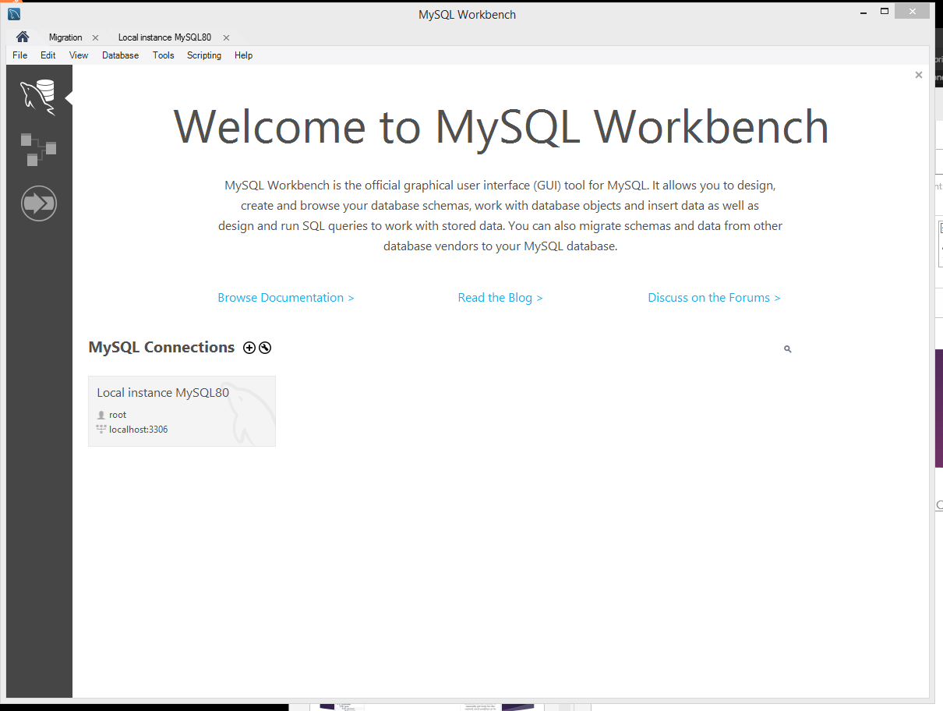
MySQL
https://dev.mysql.com/downloads/workbench/
https://dev.mysql.com/downloads/mysql/ (MySQL Server)
Notes:
https://medium.com/better-programming/building-a-spring-boot-rest-api-part-iii-integrating-mysql-database-and-jpa-81391404046a

Slide 18
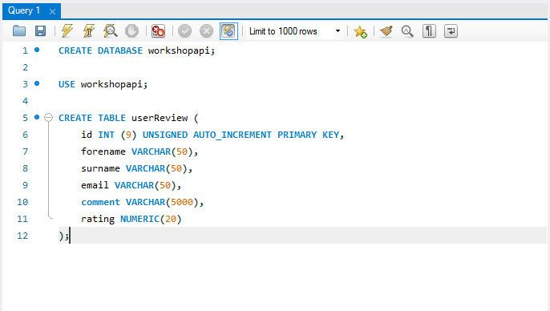
Notes:
https://www.dev2qa.com/resolve-spring-boot-jpa-table-dbname-hibernate_sequence-doesnt-exist-error/

Slide 19
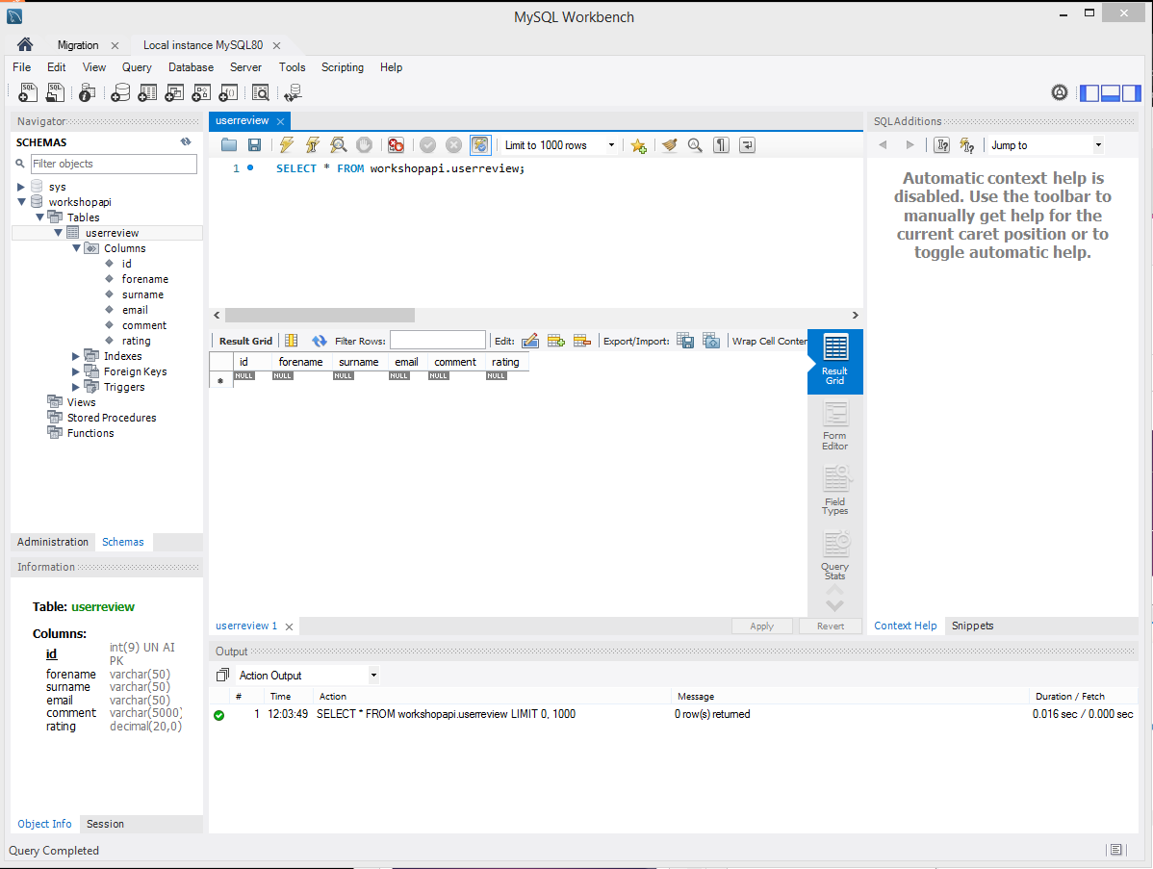

Slide 20
MongoDB
MongoDB is a general purpose, document-based, distributed database built for modern application developers and for the cloud era.
https://www.mongodb.com/
https://docs.mongodb.com/manual/tutorial/getting-started/
Notes:
https://medium.com/@gtommee97/rest-api-java-spring-boot-and-mongodb-4dffbcabbaf5

Slide 21
MongoDB Java Driver & Morphia
MongoDB Java Driver Java API that enables you to connect and perform queries in Java
https://mongodb.github.io/mongo-java-driver/
Morphia is a Java Object Document Mapper for MongoDB
https://morphia.dev/
Notes:
https://www.baeldung.com/mongodb-morphia

Slide 22
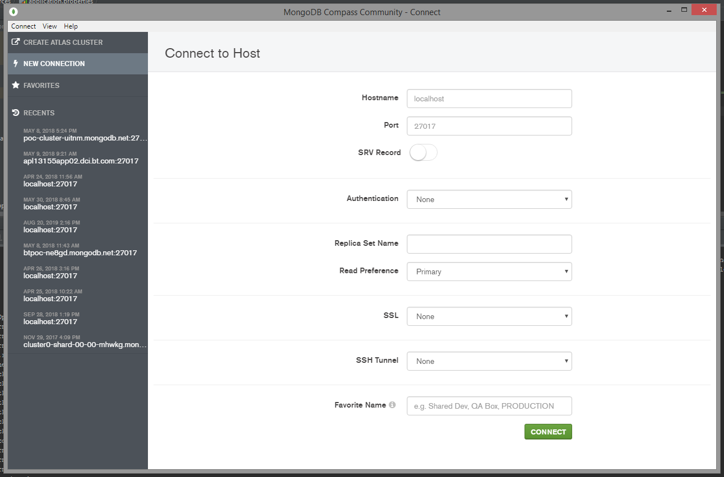
MongoDB Compass

Slide 23
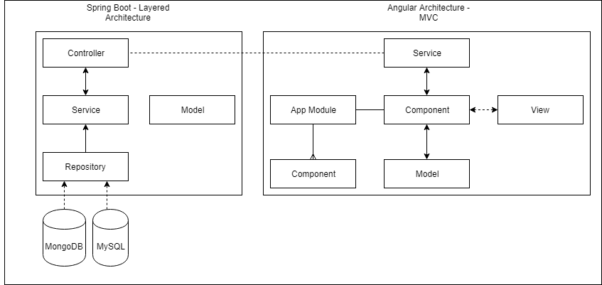
Combining it all together
Notes:
https://medium.com/@RogelioOrts/layered-architecture-spring-boot-af7dc071d2b5
https://www.petrikainulainen.net/software-development/design/understanding-spring-web-application-architecture-the-classic-way/

Slide 24
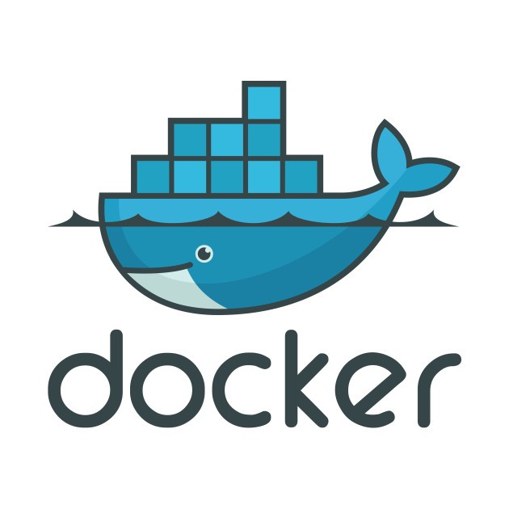
Containerize It
Docker is a tool designed to make it easier to create, deploy, and run applications by using containers. Containers allow a developer to package up an application with all of the parts it needs, such as libraries and other dependencies, and ship it all out as one package. — OpenSource.com, What is Docker?
A Dockerfile is a text document that contains all the commands a user could call on the command line to assemble an image. Using docker build users can create an automated build that executes several command-line instructions in succession.- Docker, Dockerfile Reference
Notes:
https://itnext.io/docker-101-fundamentals-the-dockerfile-b33b59d0f14b

Slide 25
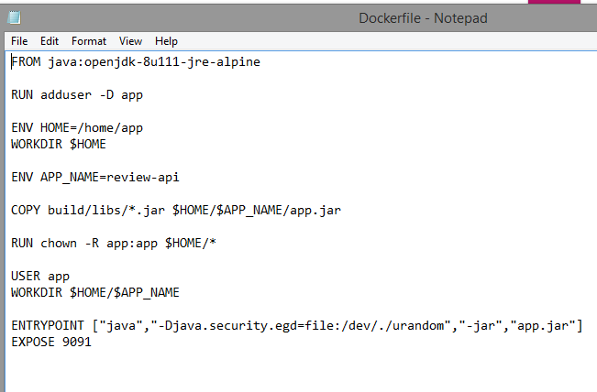
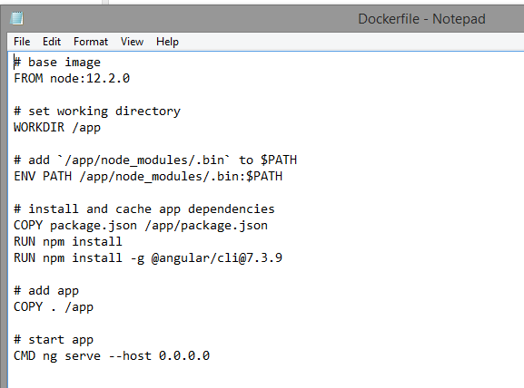
Dockerfile

Slide 26
Dockerfile Commands
FROM — this initializes a new build stage and sets the Base Image for subsequent instructions. As such, a valid Dockerfile must start with a FROM instruction.
RUN — will execute any commands in a new layer on top of the current image and commit the results. The resulting committed image will be used for the next step in the Dockerfile.
ENV — sets the environment variable <key> to the value <value>. This value will be in the environment for all subsequent instructions in the build stage and can be replaced inline in many as well.
EXPOSE — informs Docker that the container listens on the specified network ports at runtime. You can specify whether the port listens on TCP or UDP, and the default is TCP if the protocol is not specified. This makes it possible for the host and the outside world to access the isolated Docker Container
VOLUME — creates a mount point with the specified name and marks it as holding externally mounted volumes from the native host or other containers.
Notes:
https://spring.io/guides/gs/spring-boot-docker/
https://medium.com/@DenysVuika/your-angular-apps-as-docker-containers-471f570a7f2
https://mherman.org/blog/dockerizing-an-angular-app/

Slide 27
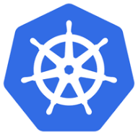


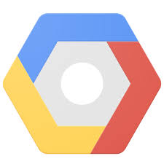



Alternatives and Clod Computing
Notes:
https://kubernetes.io/
http://mesos.apache.org/documentation/latest/architecture/
https://www.openshift.com/
https://firebase.google.com/
https://cloud.google.com/
https://aws.amazon.com/
https://azure.microsoft.com/en-gb/

Slide 28
Meet-ups
Java
https://www.meetup.com/BelfastJUG/
JavaScript
https://www.meetup.com/Belfast-JS/
https://www.meetup.com/

